Slide 1


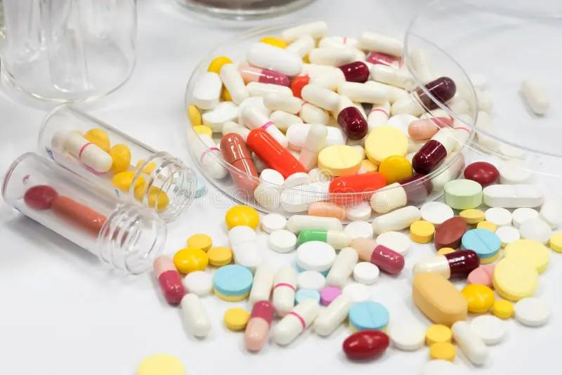

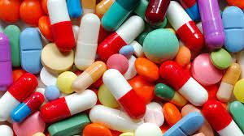



UNIVERSITY OF BASRAH / COLLEGE OF SCIENCE
M.SC.LECTURE 3
ANTIBIOTIC CLASSIFICATION AND MECHANISM OF ACTION
Department of Pathological Analyses
Presented by Prof.Dr. Saad S. Mahdi Al-Amaradi Al-Amara

Slide 2
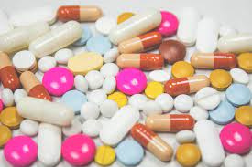
Antibiotic
  Antibiotic, Antibiotics are chemical substances produced by various microorganisms(bacteria, fungi, actinomycetes) that have the capacity to inhibit the growth or destroy other microorganisms.
  Antibiotics commonly are produced by soil microorganisms and probably represent a means by which organisms in a complex environment, such as soil, control the growth of competing microorganisms.
  Microorganisms that produce antibiotics useful in preventing or treating disease include the bacteria and the fungi.

Slide 3
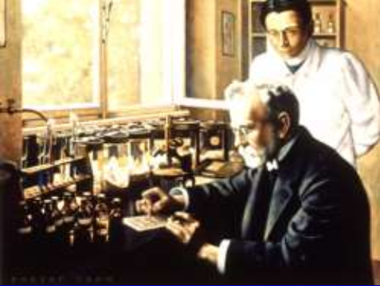
Paul Ehrlich 1910
  started science of chemotherapy
  systematic chemical modifications
  selective toxicity
  developed the Chemotherapeutic Index
Toxic Concentration
  Chemotherapeutic Index =
Effective Concentration

Slide 4
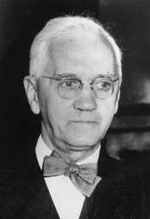
Alexander Fleming 1928
  observed the killing of staphylococci by a fungus
(Penicillium notatum)
  Florey & Chain purified it by freezedrying (1940) - Nobel prize 1945
  selective toxicity
  first used in a patient: 1942
  World War II: penicillin saved 12-15% of lives

Slide 5
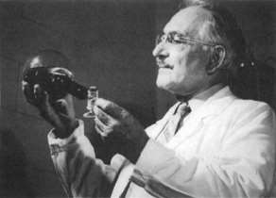
Selman Waksman - Streptomycin (1943)
  first antibiotic active against Mycobacterium tuberculosis
  extracted from Streptomyces- Nobel prize 1952
  20 other antibiotics, neomycin, actinomycin

Slide 6
Classification
  There are several ways of classifying antibiotics but the most common classification schemes are based on their molecular structures, mode of action and spectrum of activity
  Others include route of administration (injectable, oral and topical).
  Antibiotics within the same structural class will generally show similar pattern of effectiveness, toxicity and allergicpotential side effects.
  Some common classes of antibiotics based on chemical or molecular structures include Beta-lactams,Macrolides, Tetracyclines, Quinolones, Aminoglycosides, Sulphonamides, Glycopeptides and Oxazolidinones

Slide 7
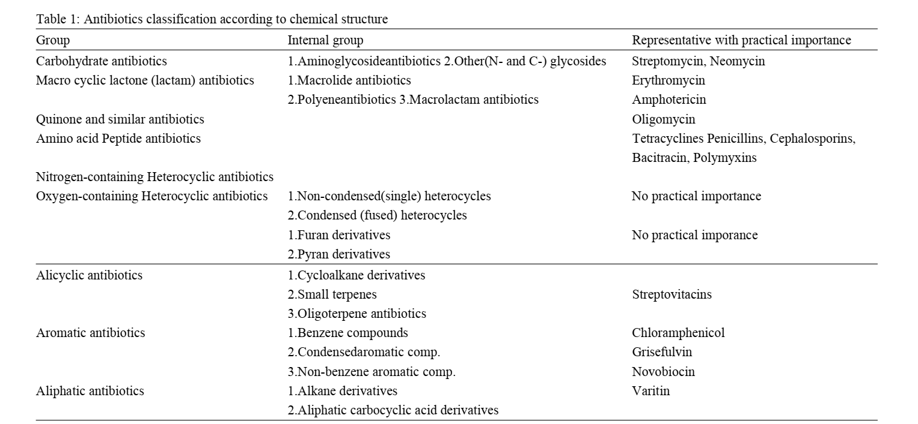

Slide 8
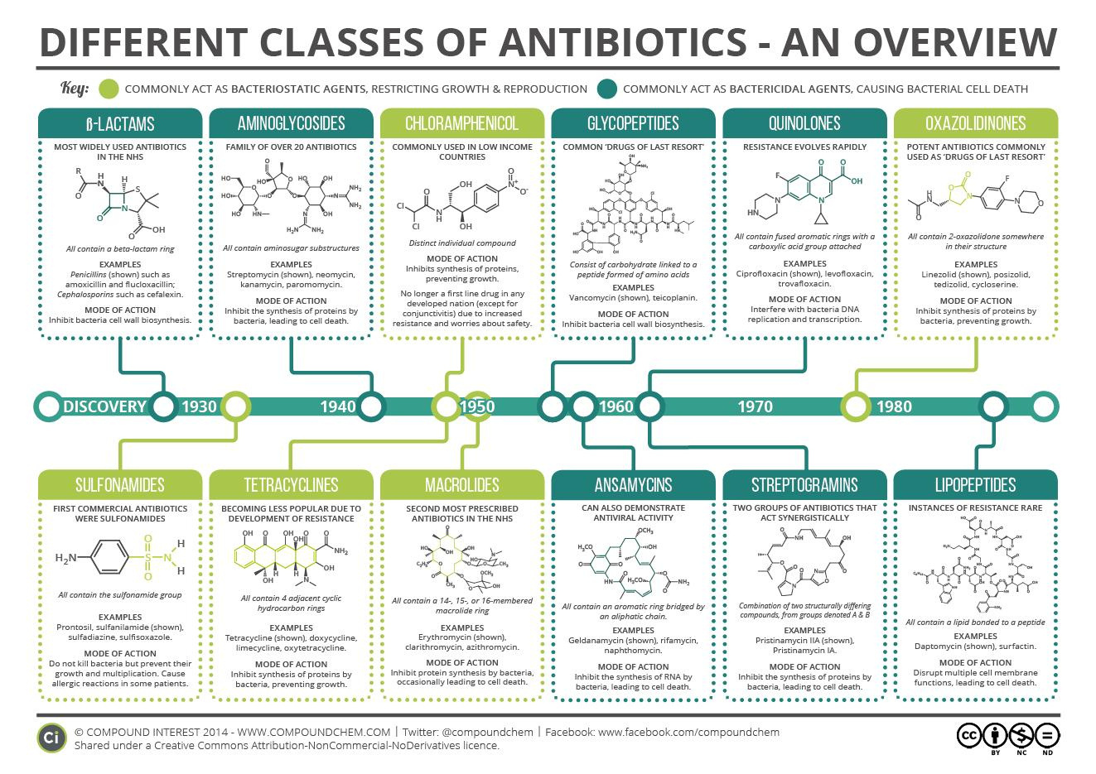

Slide 9
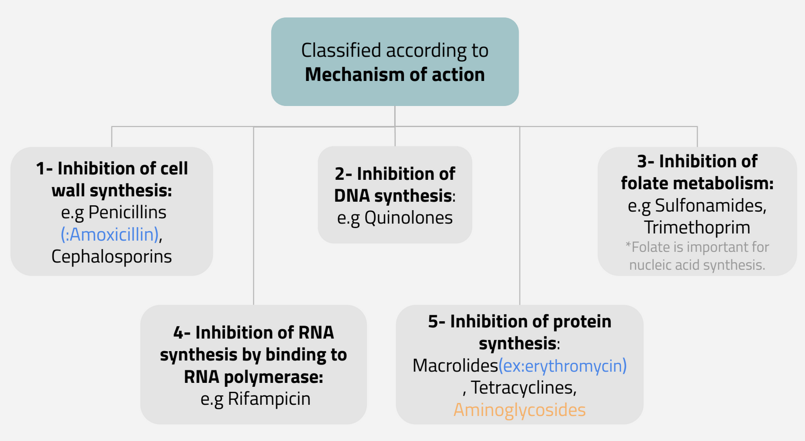
Classification according to mechanism of action

Slide 10
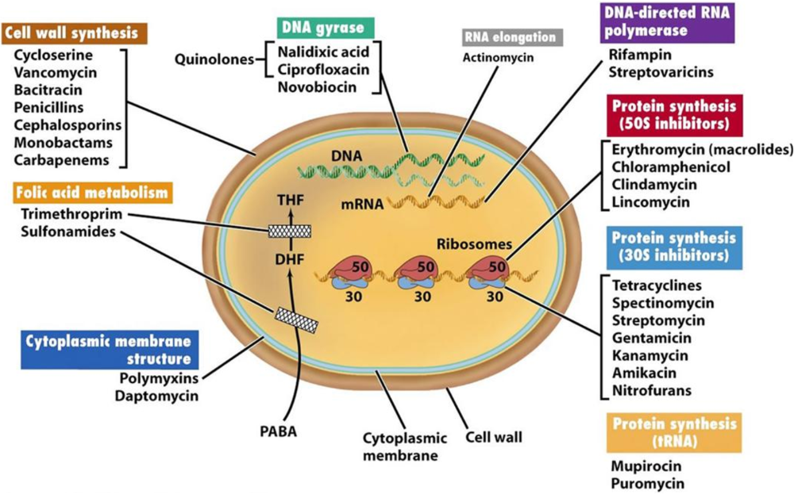

Slide 11
Classification depend on spectrum of activity
  Narrow spectrum : agent act only on a single or limited group of mocroorganism eg. Pencillin & erythromycin
  Extent -spectrum antibiotic : antibiotic that are effective against Gram positive bacteria and also against significant number of Gran negative bacteria eg. Ampicillin
  Broad-spectrum antibiotic: drug effect a wide variety of microbial species eg. Tetracycline and it cause Superinfection

Slide 12
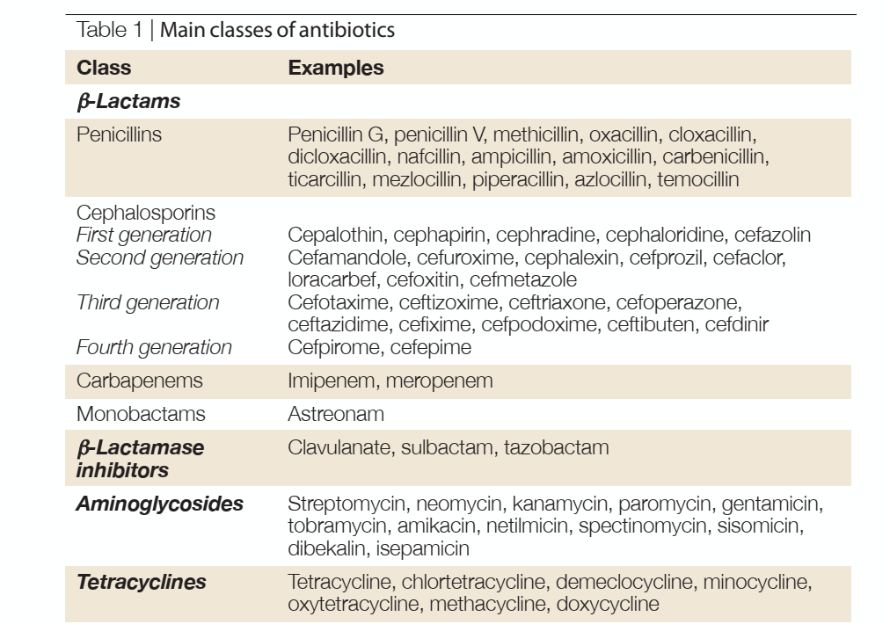

Slide 13
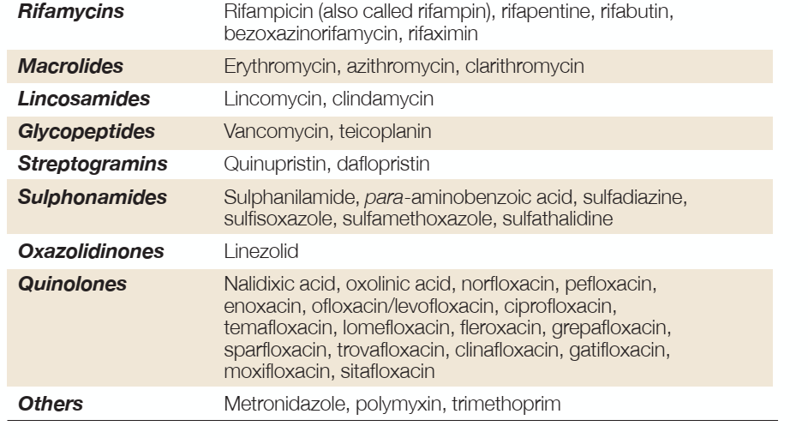

Slide 14
THAK
YOU!

